Slide 1

Browser Render Pipeline

Slide 2

Browser Render Pipeline
<
Scripting
{ }
<
Recalc Style
🔁
Layout
<
Paint
Composite
5 major key areas in the pixels-to-screen pipeline you should be mindful of

Slide 3

Browser Render Pipeline: Scripting
Scripting
<
JavaScript
typically JavaScript is used to
execute work that results in visual changes
insert / move DOM Nodes
change styles / classes
{ }

Slide 4
Browser Render Pipeline: Recalculate Styles
<
Recalc Style
Recalculate Styles
process of figuring out which CSS rule applies to which element
once known, styles are applied and calculate for each element
calculate
apply CSS to the related DOM

Slide 5
Browser Render Pipeline: Layout
<
Layout
Layout
calculate each nodes’ geometry and where it’s positioned on screen
elements affect each other, so the process has to be recursive
by far the most cost intense task for the browser to perform
calculate the nodes dimensions

Slide 6
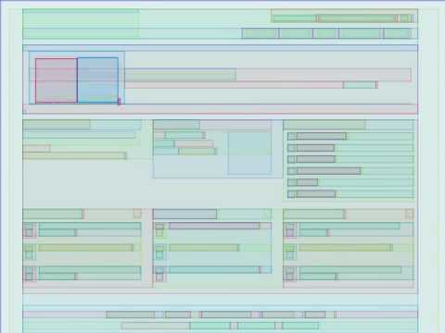
Browser Render Pipeline: Layout
<
Layout

Slide 7
Browser Render Pipeline: Paint
<
Paint
Paint
essentially, drawing every visual part of an element
colors
images
border-color
shadows
fills pixels on layers

Slide 8
Browser Render Pipeline: Composite
<
Composite
draw layers on the screen
elements potentially overlap each other
less costly task
can be run on GPU
Composite
compute overlaps of the layers

Slide 9
Why should I know?
🤔

Slide 10
Browser Render Pipeline
Every step in the pipeline invites you to introduce jank, understand what parts of the pipeline your code affects!
You can control the steps, understand what parts of the pipeline your code triggers!

Slide 11
Browser Render Pipeline
💩
Full reflow: Layout property changed
Layout no affected: Paint property changed
🔥
Neither layout nor paint: Compositor property changed
mandatory

Slide 12
Browser Render Pipeline
💡
csstriggers.com/: avoid steps in the pipeline
🔥
Aim for compositor-only properties

